Slide 1
Imagination and Perception of Rhythmic Speech
Avital
Dec 12, 2016
Data Blitz

Slide 3
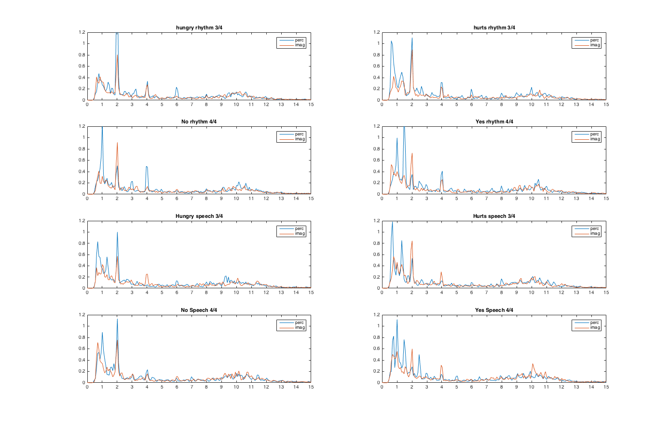
Perception vs Imagination
Beat – 2Hz
Downbeat = 0.66Hz
Downbeat =0.5Hz

Slide 4
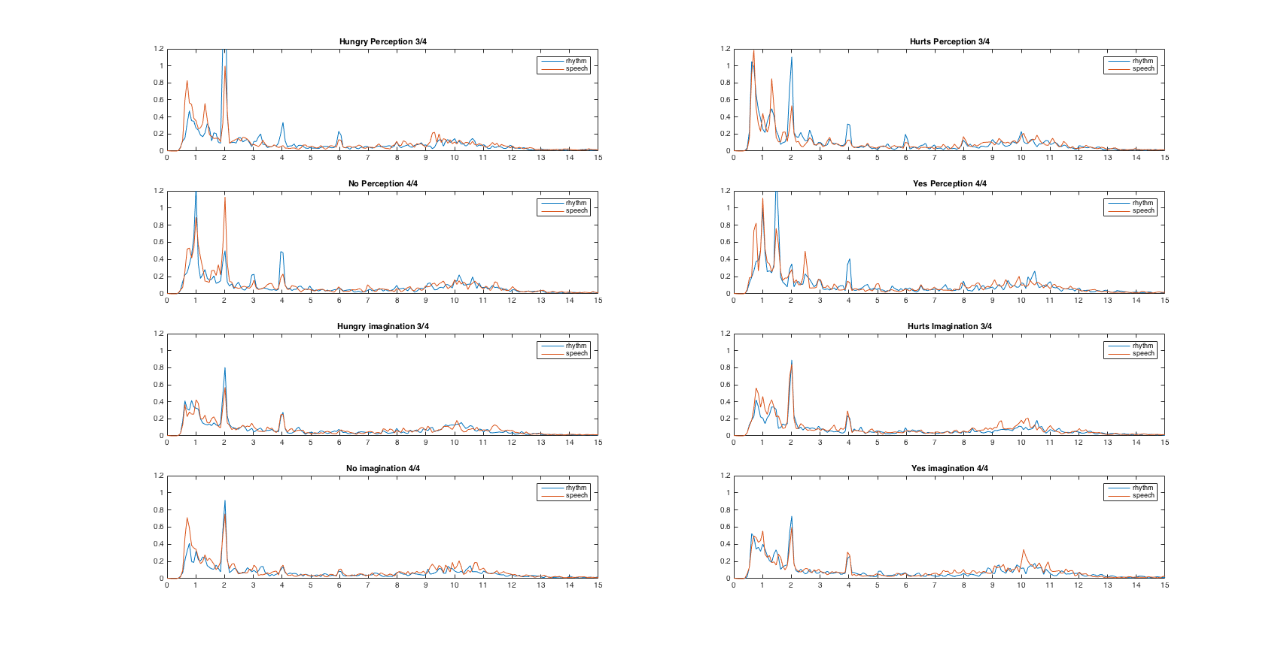
Rhythm vs Speech
Beat – 2Hz
Downbeat = 0.66Hz
Downbeat =0.5Hz

